Slide 1
Session 1:
Search Engines

Slide 2
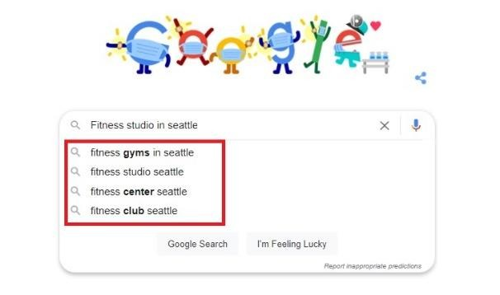
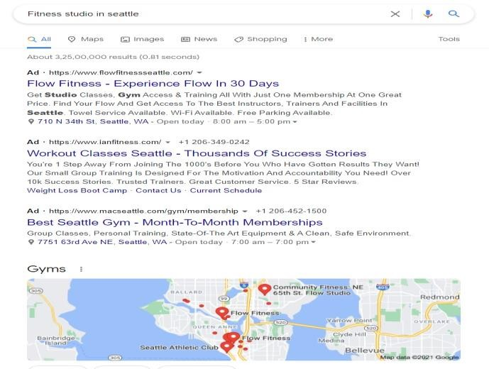
What is a Search Engine? (1-2)
A software system.
Executes query based Web search. Example Google Queries are called keywords.
Keywords appear as one begins typing.
Figure 1.1: Google Search
Search results appear in Search Engine Results Pages (SERPs)
Algorithms rank SERPs from most relevant to least
relevant.
Most relevant pages are displayed on top.
“Ads” are paid search results. (SEM – search engine marketing)
Figure 1.2: Google Search Result Page

Slide 3









What is a Search Engine? (2-2)
Working of Search Engine
Search bots - spiders or crawlers search for information on Internet.
Scan Websites for text, images, ads.
Analyze elements of data – metadata, keywords.
Automated Programs
Categorize
Crawled content in database - search index.
Display search results from search index.
Algorithms
Rank information.
Display search results based on most relevant content.
Differ in other search engines.
Ranking factors - mobile friendliness, content freshness, relevance.

Slide 4



Components of a Search Engine
Web Crawler
Spider or bot
Indexes content from Internet
Analyzes pages for relevant results
Search Interface
Place to enter search query
Displays search results
Database
Storehouse of indexed information - titles, headers, Web addresses
Frequently updated

Slide 5

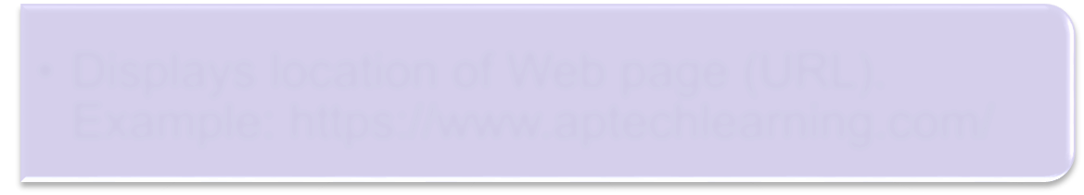

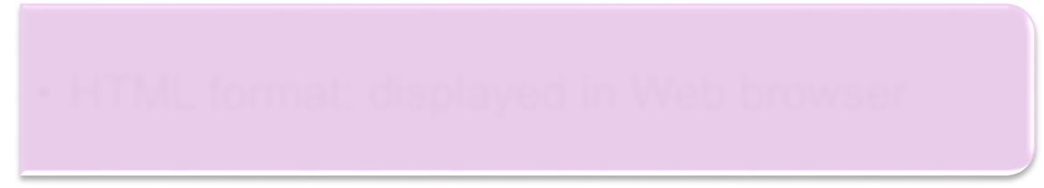

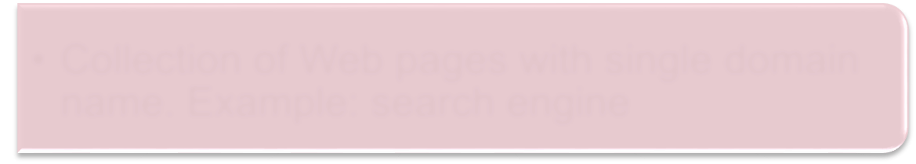
Web Pages and Websites
Web Address
Web Page Website
Displays location of Web page (URL).
Example: https://www.aptechlearning.com/
HTML format; displayed in Web browser
Collection of Web pages with single domain
name. Example: search engine

Slide 6
Search Engines and Their Origin
1990
Archie – the first search engine
2004 MSN
– New Search Engine
1996
AskJeeves
1994
Yahoo! Search Lycos
1998
Google
2009 Bing

Slide 7
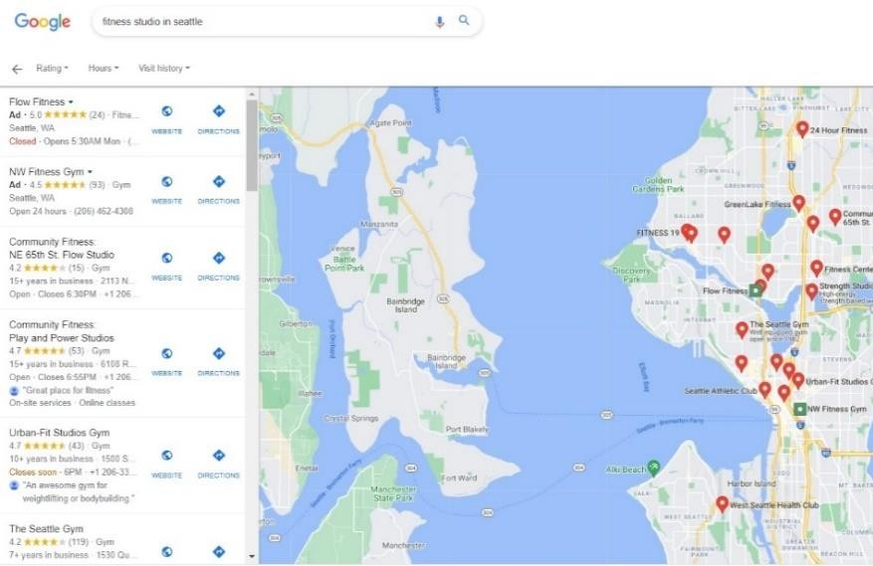
The Perfect Google Search
New updates announced here: https://support.google.com/websearch/announcements/9587893
Voice - “Hey Google”
Figure 1.3: Microphone icon
Ways to Search
Location - To view information specific to location
Type in search bar
Figure 1.4: Location-Specific Information

Slide 8

Advanced Google Search Techniques and Strategies
Place
Advanced Search
Find Exact Match
words in quotes
Search Social Media
Use @ before word
Settings >> Advanced Search
Search within range of numbers
Use .. between two numbers
Find pages with…
Use # before word
Narrow your results by…
Hashtags
Use $ before number
Price

Slide 9
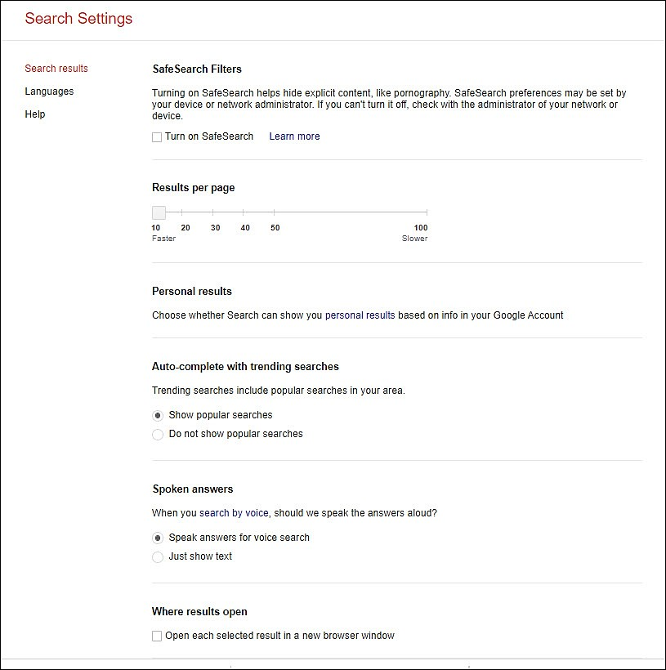
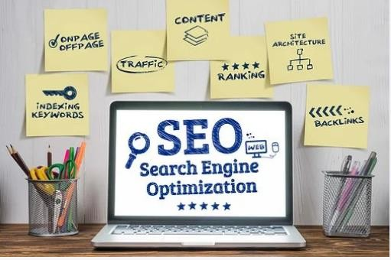
Google Search Settings
SafeSearch preferences
Auto-complete with trending searches Speak answers for voice search Open result in new window
Save search history
Figure: Search Settings Page

Slide 10






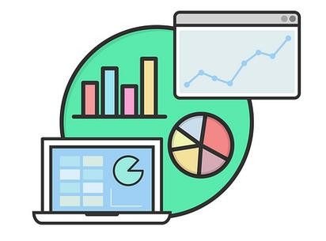
Working of Google Search
Crawling
Finding new/updated pages from links, Web host; and maintains the list on Google.
Indexing
Analyzing and storing pages, with images and
videos.
Serving
Serves search answers after considering several factors, such as language and location.
Factors affecting ranking
Useful content
Mobile friendliness
Faster page loading
SEO guidelines

